Slide 1
ALDEHYDE AND KETONES
Sixth Semester
Organic Chemistry II
Dr.S Sreelatha
Department of Chemistry
NSS Colllege Pandalam

Slide 2
Aldehydes and ketones are compound containing carbonyl groups (>C=O)
In aldehyde the CO group is linked either to two H atoms or to one H atom and one alkyl or aryl group.
In ketones CO group is linked to two alkyl or aryl group.
General formula of aldehyde :
R-CHO
General formula of ketones :
R-CO-R’

Slide 3
Structure of Carbonyl group
Both carbon and oxygen in CO group are sp² hybridized.
The carbon atom forms three σ bond at 120º to each other.
The double bond between carbon and oxygen contain a σ and a bond
The ∏ electron cloud is displaced towards the oxygen atom. This causes polarisation in the carbonyl group (2.3-2.8 D)

Slide 4
Acidity of α- Hydrogens
α-Hydrogen of aldehyde and ketones are acidic.ie, they can be released as a protons.
This acidity is due to the fact that anion formed by the release of the α-Hydrogen as a proton is stabilized by resonance.

Slide 5
Witting reaction
The Wittig reaction is a chemical reaction of an aldehyde or ketone with a triphenyl phosphonium ylide to give an alkene and triphenylphosphine oxide.

Slide 6
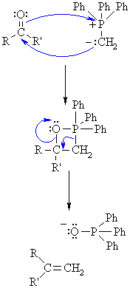
Mechanism
Step 1: The nucleophilic C of the ylid Wittig reagent adds to the electrophilic C in the polar carbonyl group, electrons from the C=O π bond are used to form a σ bond to the +ve P atom. This creates a cyclic intermeiate called an oxaphosphetane.
Step 2: Decomposition of the intermediate by breaking the C-Pand C-O σ bonds leads to the formation of the C=C π bond of the alkene and triphenyl phosphine oxide.
+

Slide 7
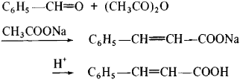
Perkins reactions
The Perkin reaction is an organic reaction that is used to make cinnamic acids. It gives an α,β-unsaturated aromatic acid in the presence of an alkali salt of the acid.

Slide 8
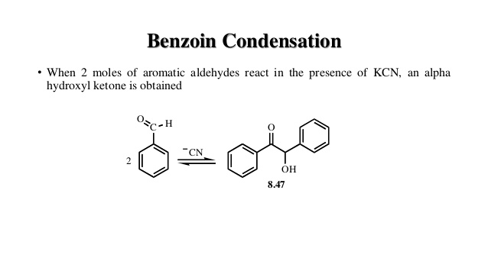
Benzoin condensation

Slide 9
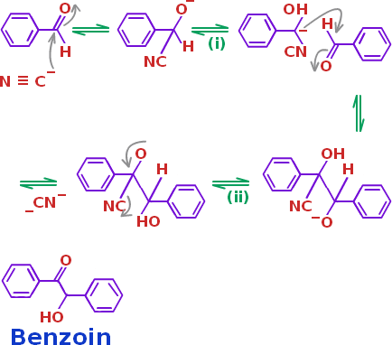
Mechanism
In the first step, the cyanide ion reacts with benzaldehyde to form cyanohydrin.
Condensation reaction takes place between the cyanohydrin and benzaldehyde.
Rearrangement takes place and the removal of cyanide ion results in the formation of Benzoin.

Slide 10
Knoevenagel reaction
The Knoevenagel reaction is a variant of the aldol condensation historically performed with malonic acid (or malonate ethyl), although it can theoretically be performed with any 1 - 3 dicarbonyl compound (β- dicarbonyl)
C₆H₅CHO + CH₂(COOC₂H₅)₂
C₆H₅CH=C(COOC₂H₅)₂
C₆H₅-CH=CH-COOH

Slide 11
Mannich reaction
The Mannich reaction is an organic reaction which consists of an amino alkylation of an acidic proton placed next to a carbonylfunctional group by formaldehyde and a primary or secondary amine or ammonia. The final product is a β-amino-carbonyl compound.

Slide 12
Cannizzaro’s reaction
The Cannizzaro reaction, named after its discoverer Stanislao Cannizzaro, is a chemical reaction that involves the base-induced disproportionation of two molecules of a non-enolizable aldehyde to give a primary alcohol and a carboxylic acid.
2 HCHO + NaOH CH₃OH + HCOONa
2 C₆H₅CHO + KOH → C₆H₅CH₂OH + C₆H₅COOK

Slide 13
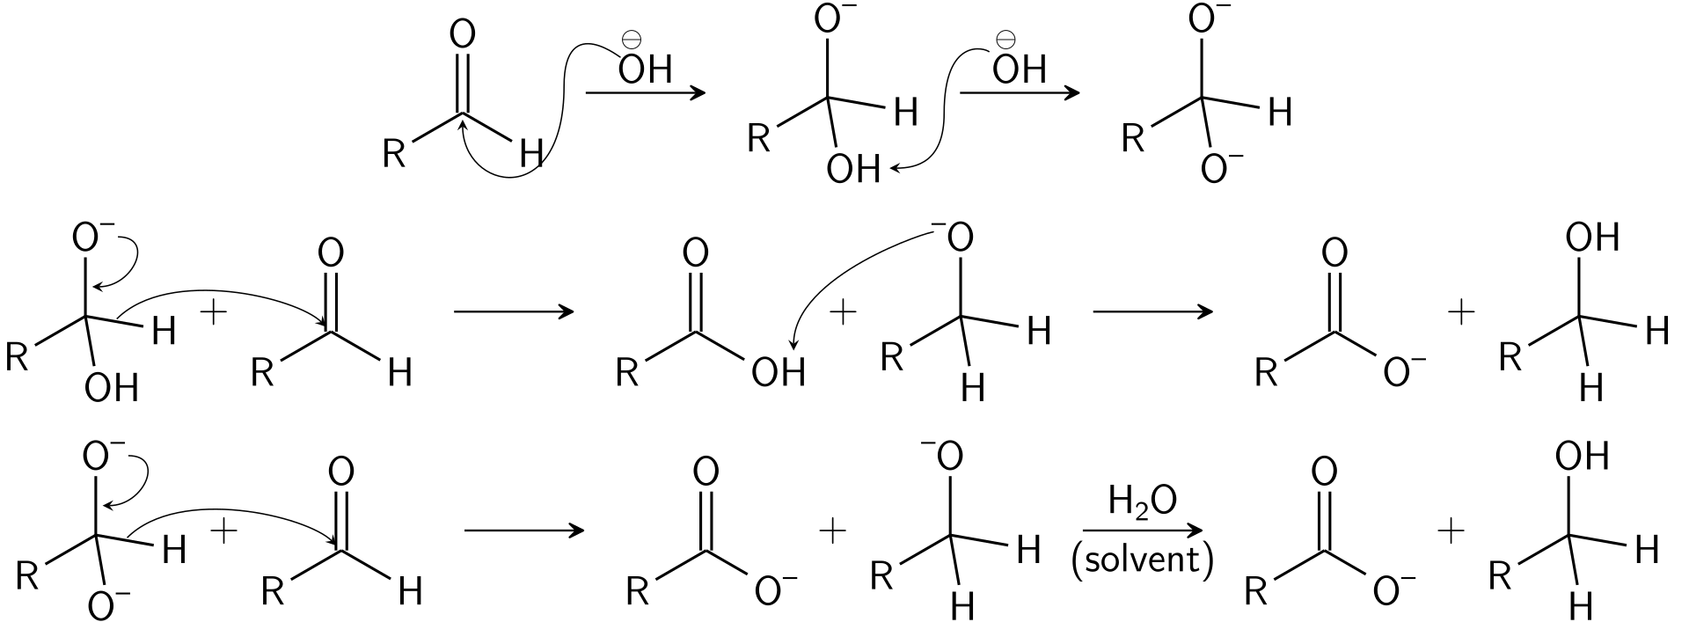
MECHANISM

Slide 14
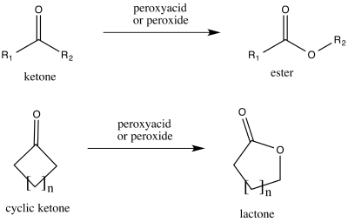
The Baeyer- Villinger oxidation
The Baeyer–Villiger oxidation is an organic reaction that forms an ester from a ketone or a lactone from a cyclic ketone, using peroxyacids or peroxides as the oxidant

Slide 15
Clemmenson reduction
Clemmensen reduction is a chemical reaction described as a reduction of ketones (or aldehydes) to alkanes using zinc amalgam and concentrated hydrochloric acid.

Slide 16
Wolf-Kishner reduction
The reduction of aldehydes and ketones to alkanes.
Condensation of the carbonyl compound with hydrazine forms the hydrazone, and treatment with base induces the reduction of the carbon coupled with oxidation of the hydrazine to gaseous nitrogen, to yield the corresponding alkane.

Slide 17
Reduction with LiAlH₄/NaBH₄
Aldehydes and ketones are most readily reduced with hydride reagents
The reducing agents LiAlH₄ and NaBH₄ act as a source of 4 x H⁻ (hydride ion)
Overall 2 H atoms are added across the C=O to give H-C-O-H
Hydride reacts with the carbonyl group, C=O, in aldehydes or ketones to give alcohols.
The substituents on the carbonyl dictate the nature of the product alcohol.
Reduction of methanal (formaldehyde) gives methanol.
Reduction of other aldehydes gives primary alcohols.
Reduction of ketones gives secondary alcohols.
The acidic work-up converts an intermediate metal alkoxide salt into the desired alcohol via a simple acid base reaction

Slide 18
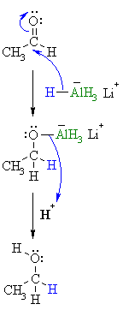
Mechanism
Step 1: The nucleophilic H in the hydride reagent adds to the electrophilic C in the polar carbonyl group in the aldehyde, electrons from the C=O move to the O creating an intermediate metal alkoxide complex.
Step 2: This is the work-up step, a simple acid/base reaction. Protonation of the alkoxide oxygen creates the primary alcohol product from the intermediate complex.

Slide 19
Meerwein-Ponndorf-Verley Reduction
The Meerwein–Ponndorf–Verley (MPV) reduction in organic chemistry is the reduction of ketones and aldehydes to their corresponding alcohols utilizing aluminium alkoxide catalysis in the presence of a sacrificial alcohol.

Slide 20
Action of Grignad reagent
Grignard reagents react with the carbonyl group, C=O, in aldehydes or ketones to give alcohols.
The substituents on the carbonyl dictate the nature of the product alcohol.
Addition to methanal (formaldehyde) gives primary alcohols.
Addition to other aldehydes gives secondary alcohols.
Addition to ketones gives tertiary alcohols.
The acidic work-up converts an intermediate metal alkoxide salt into the desired alcohol via a simple acid base reaction.

Slide 21
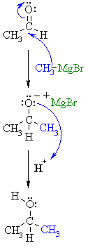
Mechanism
Step 1: The nucleophilic C in the organometallic reagent adds to the electrophilic C in the polar carbonyl group, electrons from the C=O move to the electronegative O creating an intermediate metal alkoxide complex.
Step 2:
This is the work-up step, a simple acid / base reaction. Protonation of the alkoxide oxygen creates the alcohol product from the intermediate complex.

Slide 22
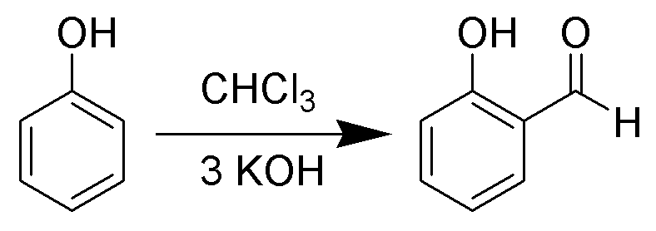
Reimer-Tiemann Reaction
The Reimer–Tiemann reaction is a chemical reaction used for the ortho-formylation of phenols; with the simplest example being the conversion of phenol to salicylaldehyde.

Slide 23
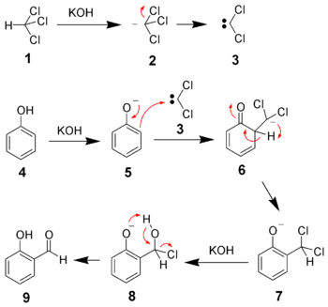
Mechanism

Slide 24
Beckmann Rearrangement
The acid-catalyzed conversion of an oxime into an amide is known as Beckmann rearrangement

Slide 25
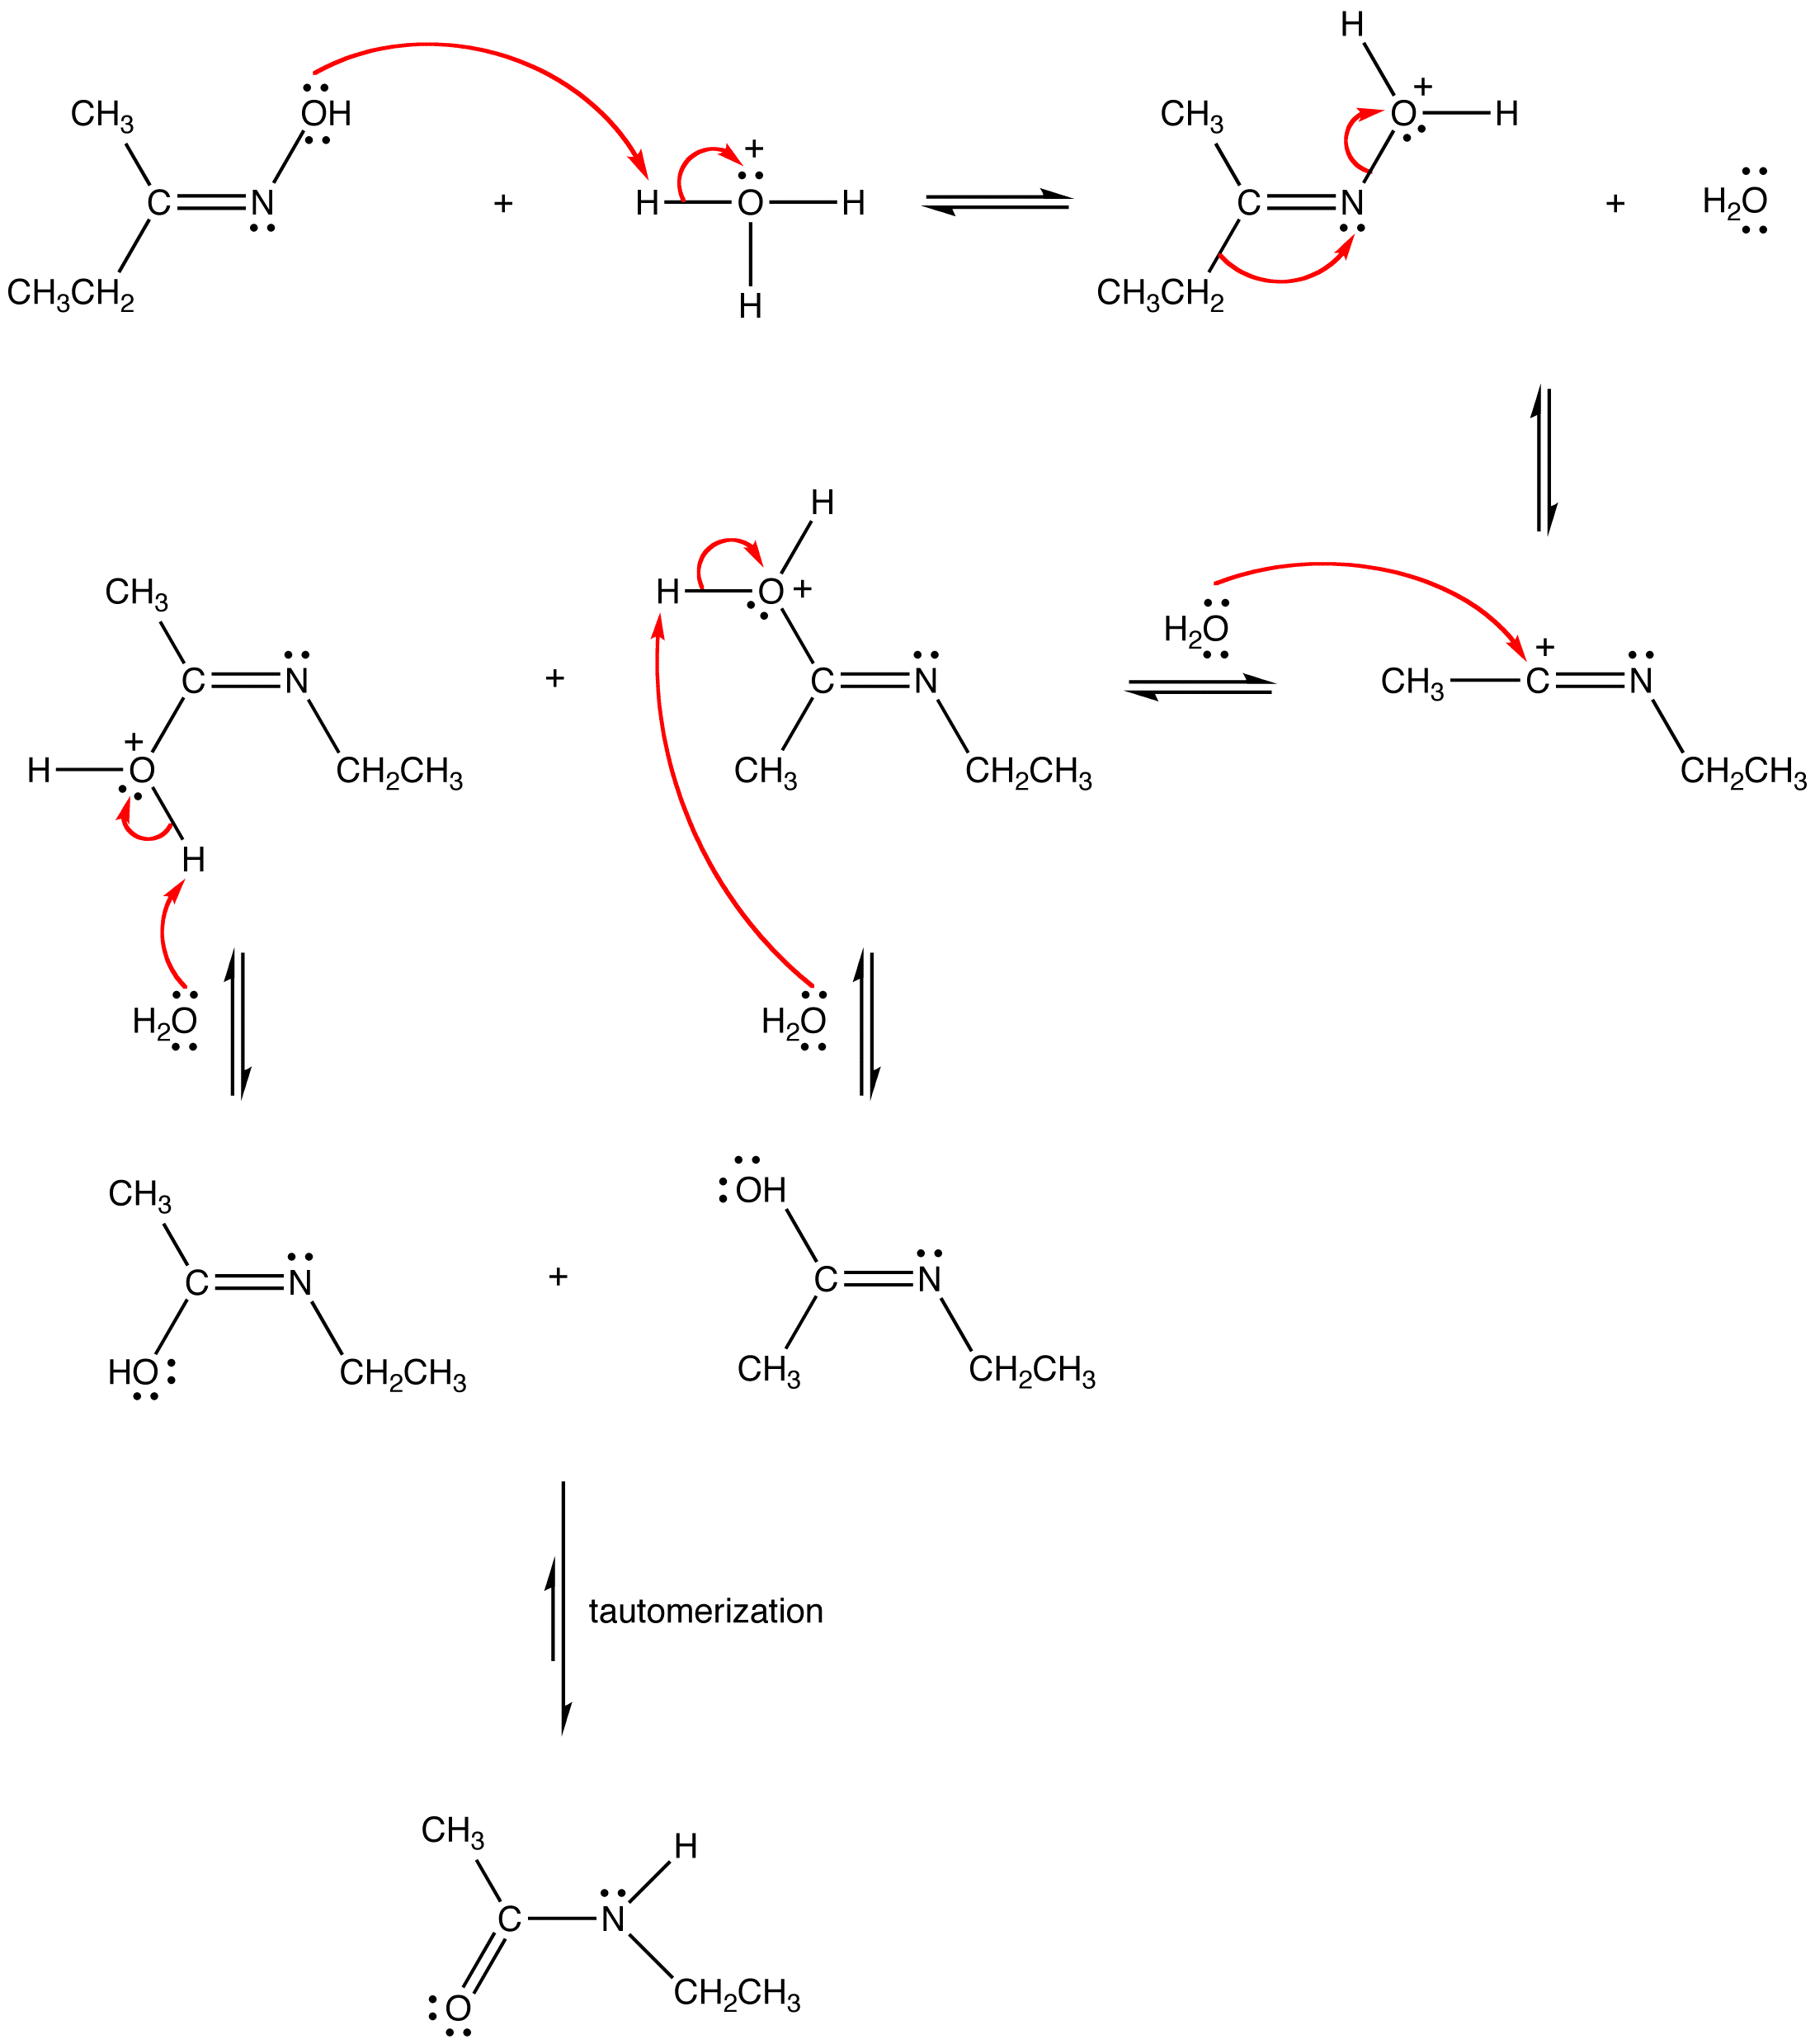
Mechanism

Slide 26
Thank You
Dr S. Sreelatha,
Department of Chemistry

